Slide 1
System Software Lab(CS 241)
Project
Feedback Portal System

Slide 2
Language Used
HTML
PHP
mysql
Java Script

Slide 3
Features :
Faculty can see feedback submitted directly by logging in to their Accounts.
Admin Login for editing database, adding course, removing course using GUI directly.
Almost all pages are dynamic.
Captcha

Slide 4
What we learned
From basic level to in depth knowledge of HTML and PHP.
Learned how user account system works in websites.($_SESSIONS)
Database manipulating, querying.
How Captcha works.

Slide 5
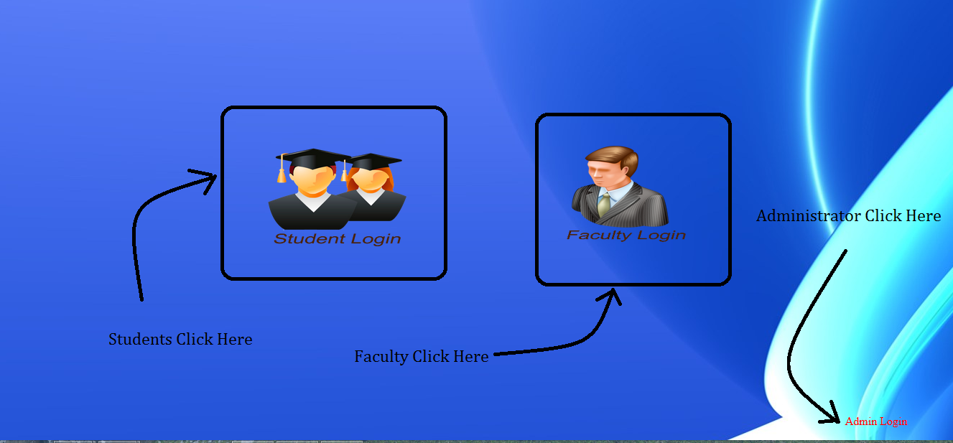
Login Portal

Slide 6
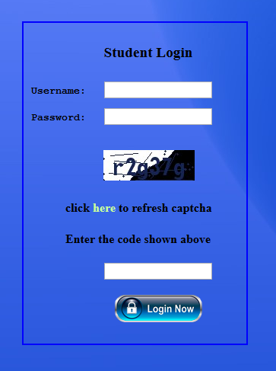
Student Login Portal

Slide 7
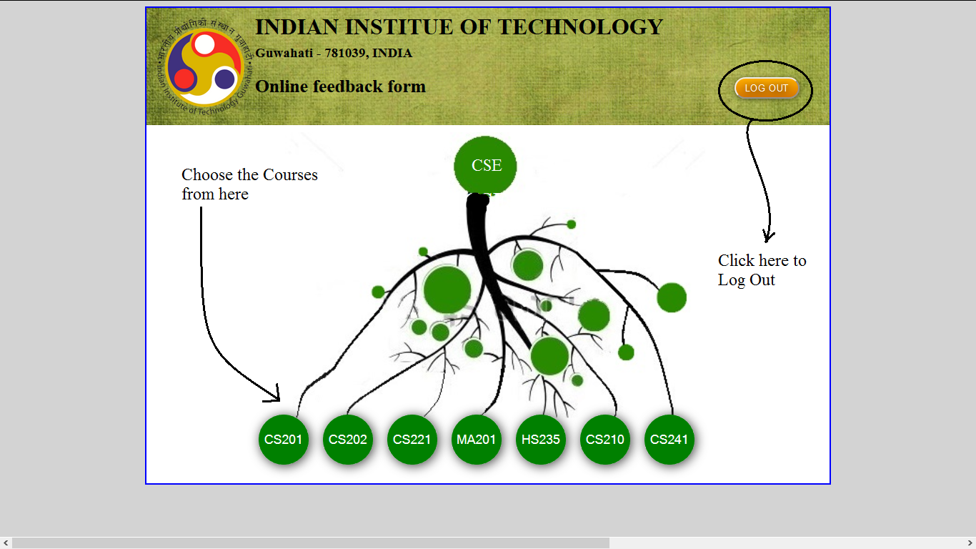
Course Menu

Slide 8
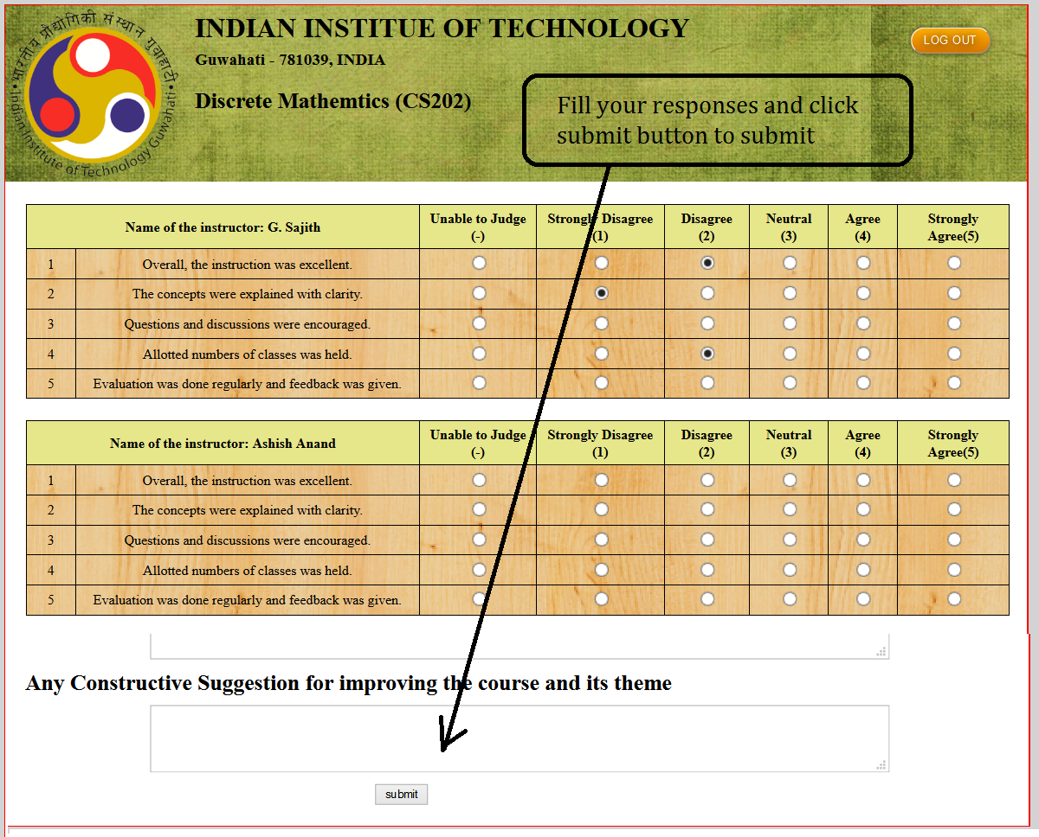
Fill The Feedback Form

Slide 9
Student Feedback Submitted

Slide 10
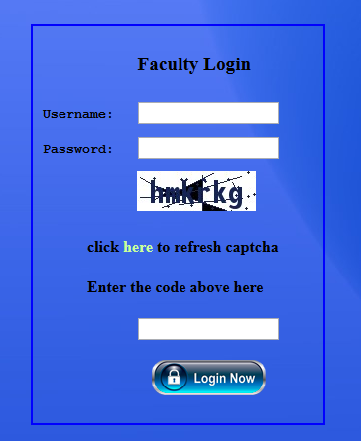
Faculty Login Portal

Slide 11
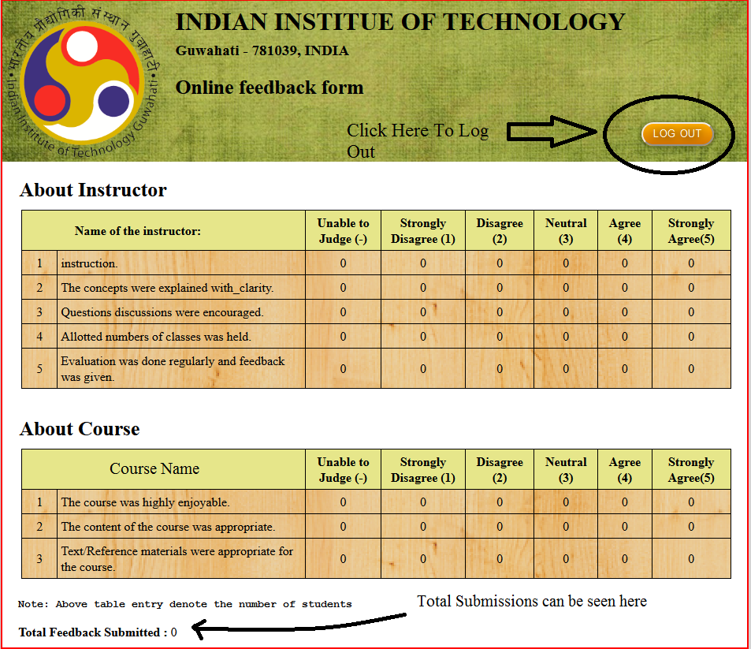
Student’s Response

Slide 12
Faculty Has Successfully Log Out

Slide 13
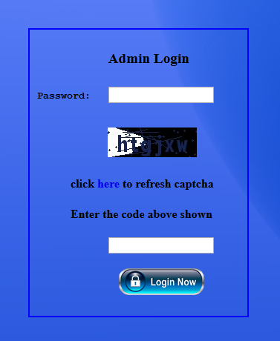
Admin Login

Slide 14
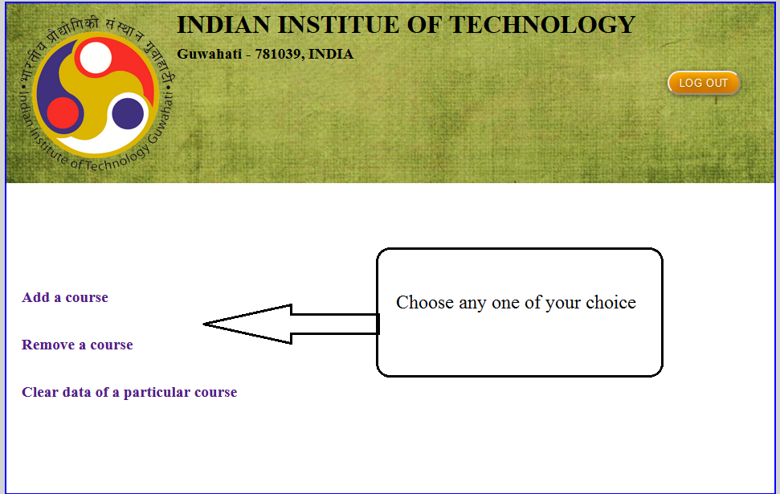
Choose Any One

Slide 15
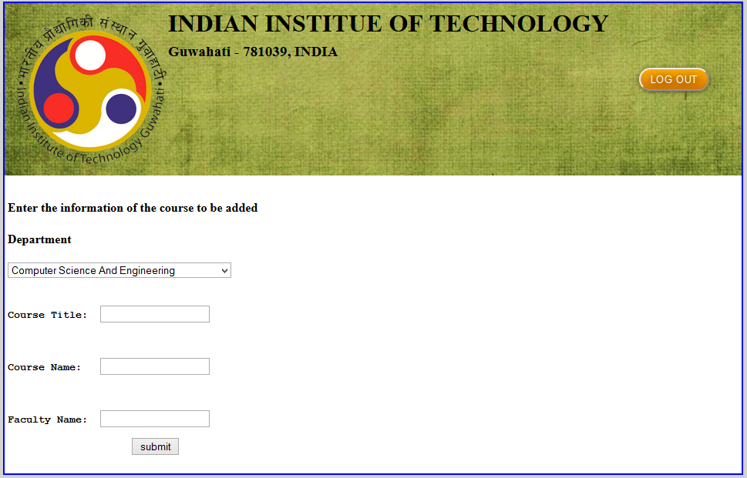
Add a Course

Slide 16
Course Added Successfully

Slide 17
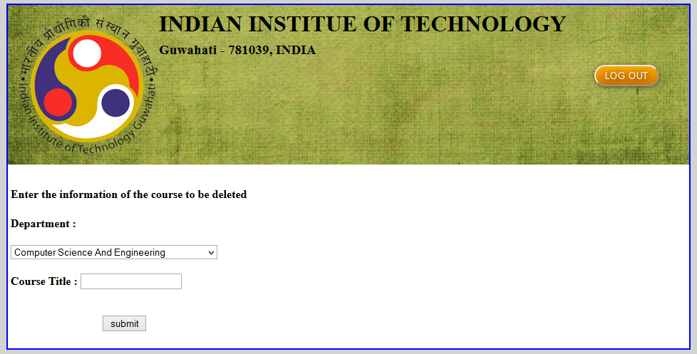
Delete a Course

Slide 18
Course Deleted Successfully

Slide 19
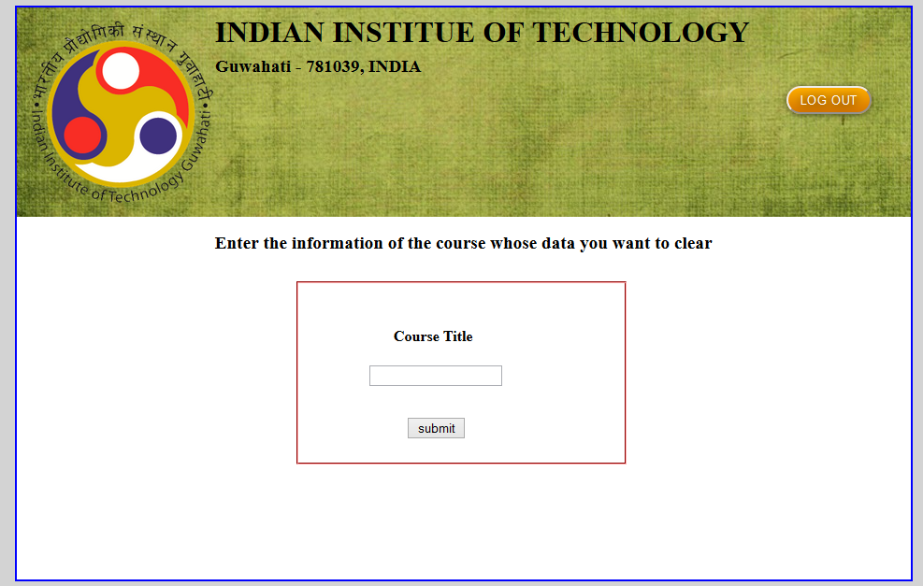
Clear Data Of A Course

Slide 20
Data Cleared Successfully

Slide 21
THANKS

